Slide 1

FogGuard
Roadside Fog Density Monitoring & Accident Prevention System
Mid Evaluation – Progress Presentation
Group 18 | Embedded Systems Design
Faculty of Engineering

Slide 2

Problem Statement
Fog greatly reduces visibility, specially during
night driving, increasing the risk of road accidents.
Mountain roads, winding roads, and forest
areas are highly prone to fog-related accidents.
Drivers entering fog-affected areas without prior
warning are unaware of the danger ahead.
Drivers who stop and wait for fog to clear still
face a high risk of accidents due to poor visibility.

Slide 3
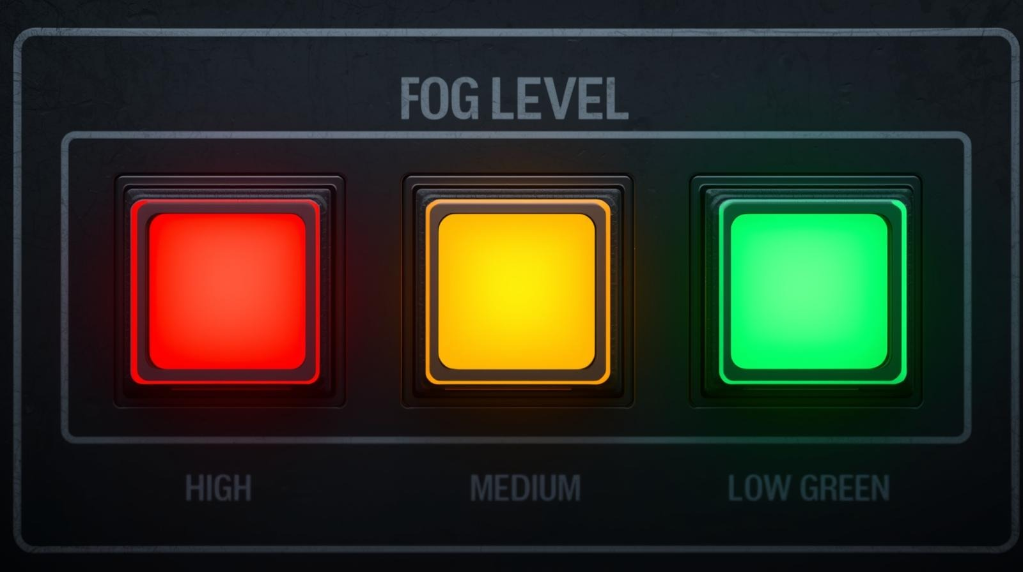
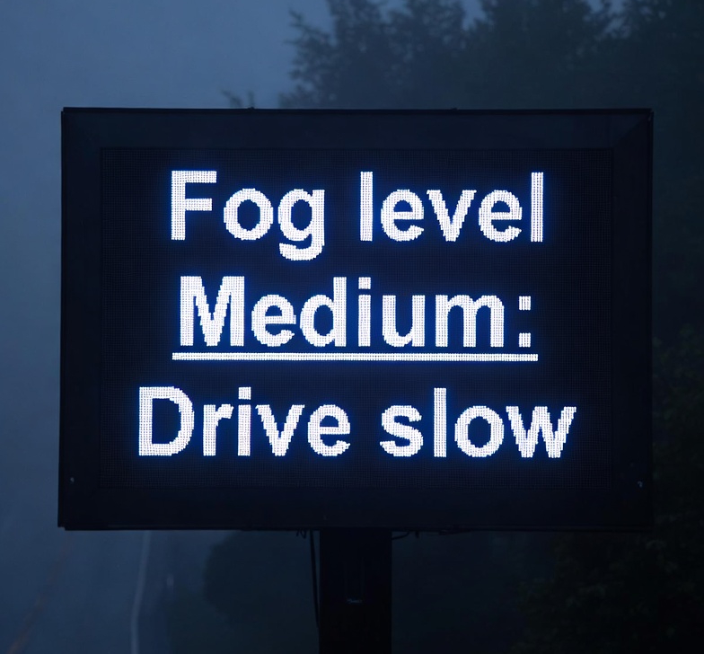
Proposed Idea
Inform drivers about fog conditions approximately
1 km before entering fog affected areas using a
wireless warning system.
Display fog level using an LCD and three LED
indicators for easy understanding.
The system is designed to be low cost, low power, easy
to implement.

Slide 4

Project Objectives
Detect fog density in real time
Measure environmental humidity
Transmit data wirelessly using LoRa
Provide visual warning to drivers
Develop a low power embedded system

Slide 5
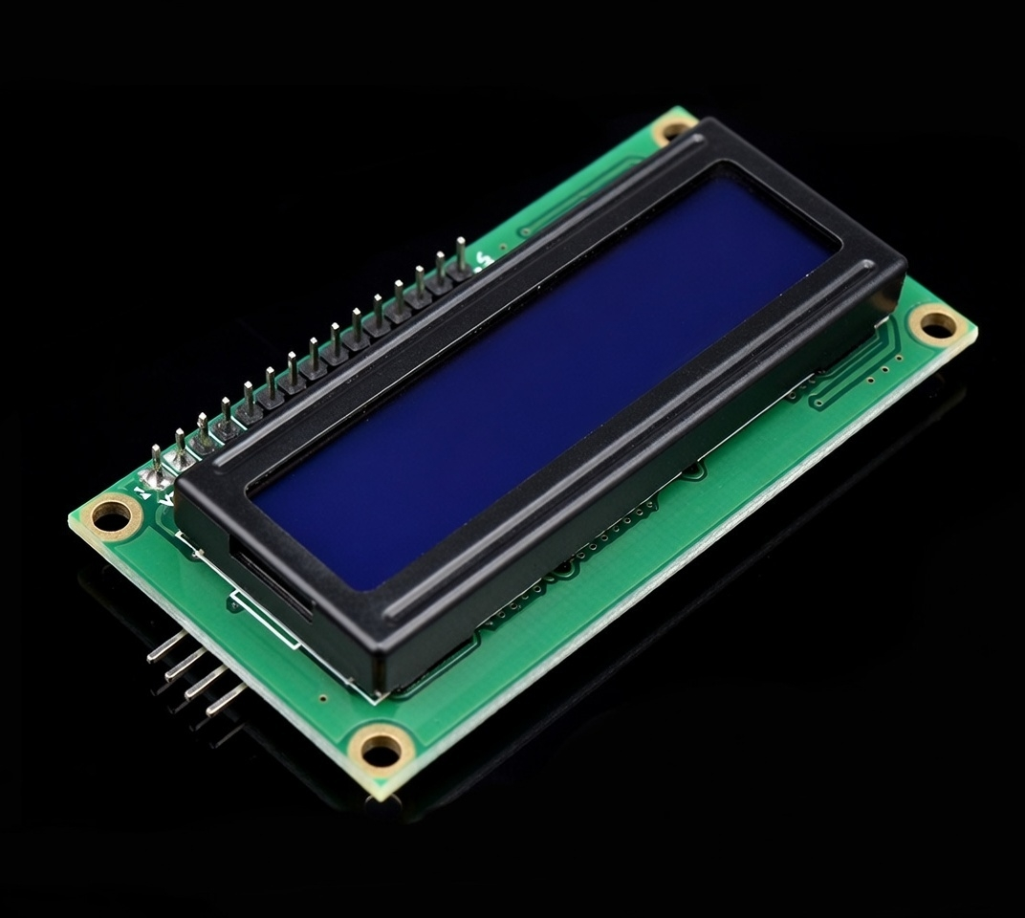
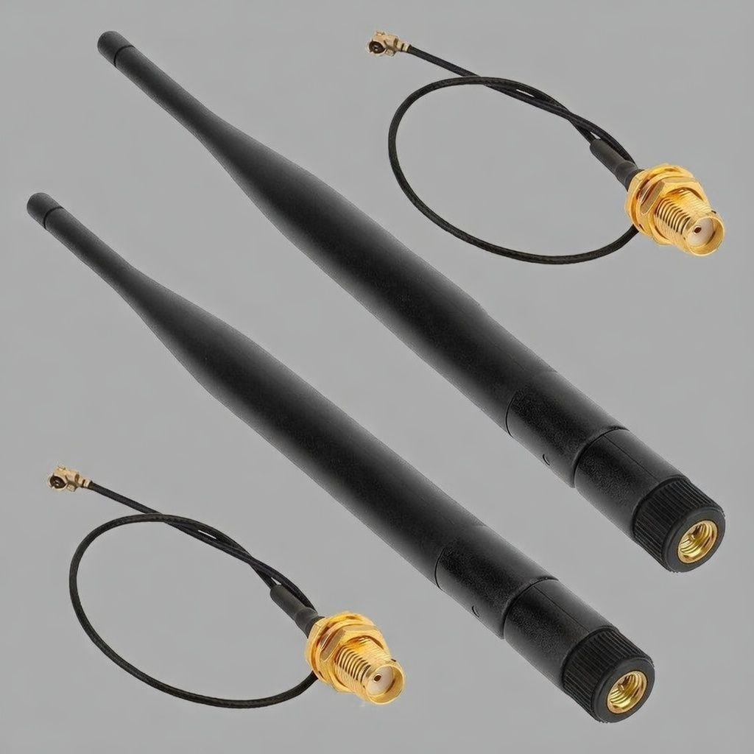
Hardware
Components
ATmega328PU Microcontroller
LoRa Modules
DHT22 Sensor
IR Sensor Pair (Emitter and Receiver)
LCD Display
LED Indicators

Slide 6
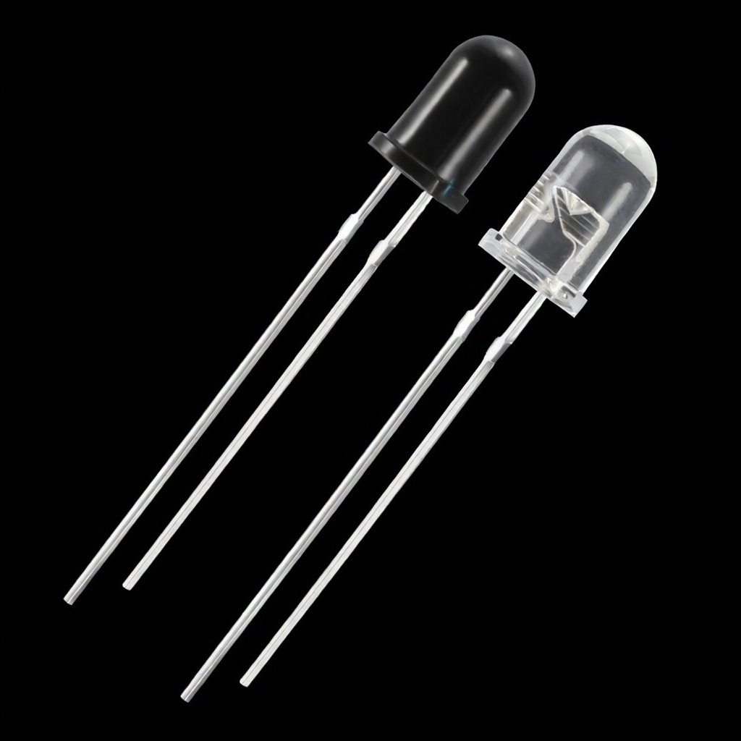
Why IR Sensors?
Detects only infrared rays, not normal visible light.
Less affected by headlights or background light, unlike LDR and photocell.
Gives more stable and accurate readings.
Low cost and easy to use,consumes less power. More reliable than LDR or photocell for this application.

Slide 7
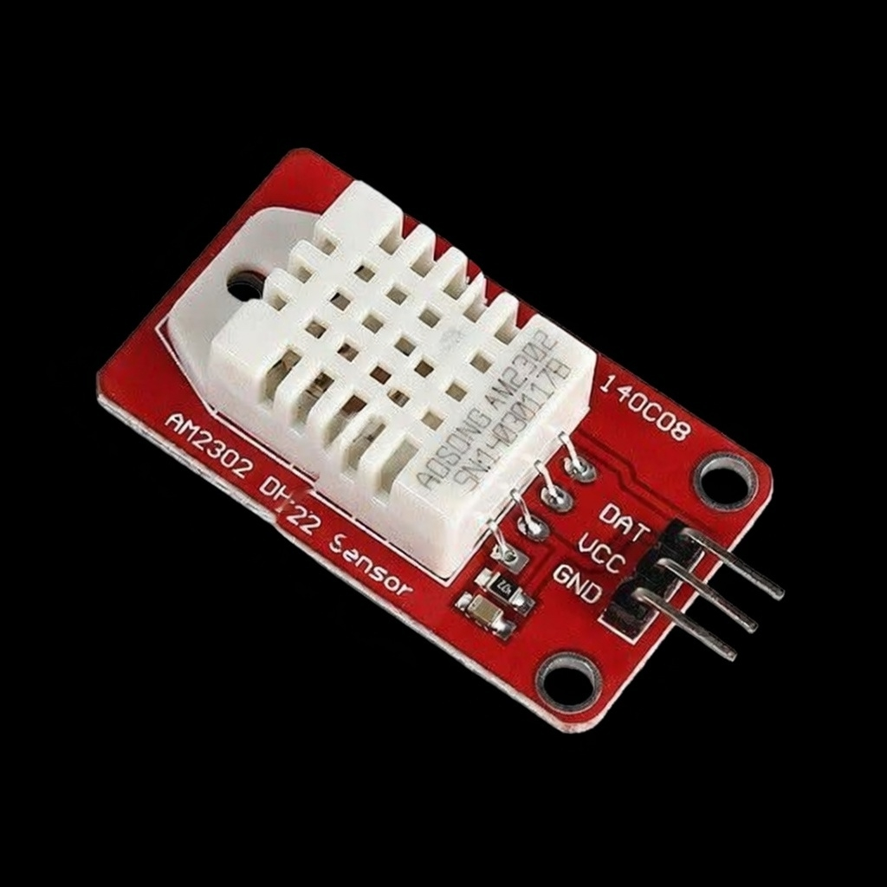
Why DHT22 Temperature and
Humidity Sensor?
Can measures both temperature and humidity using one sensor.
Gives digital output, so no complex circuit is needed.
Has good accuracy for normal environmental monitoring.
Low cost and consumes low power.

Slide 8
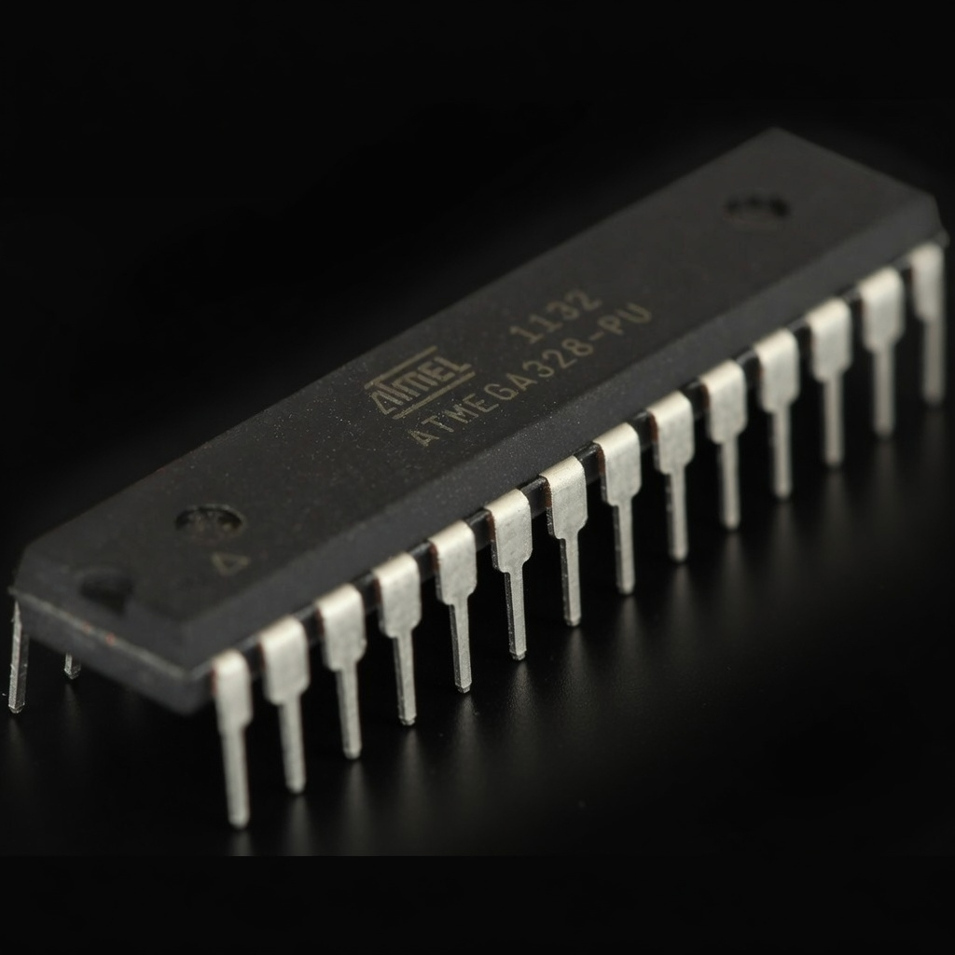
Why ATmega328P?
Consumes less power.
Low cost.
Has built-in features like ADC, timers, and communication ports.
Easy to program and implement.
Cost-effective for this system.

Slide 9
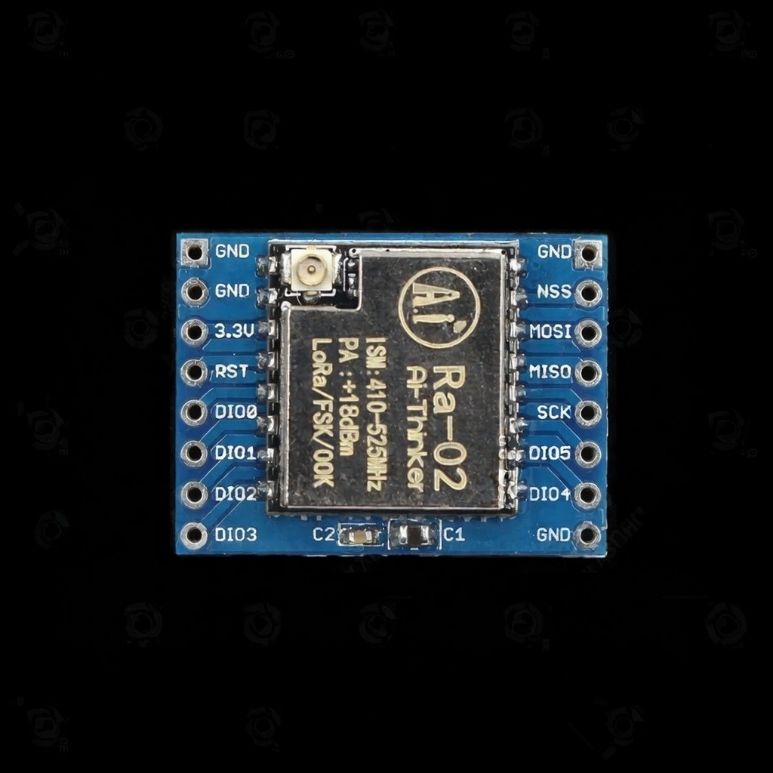
Why LoRa Module?
Supports long range communication.
Consumes low power.
Moderate in cost.
Easy to set up for point to point communication.
Reduces communication errors over average distances.
Reliable and energy efficient communication.

Slide 10


High Level System Architecture
DHT22
ATmega328p
rr
IR Transmitter and Receiver
Humidity
Sensor
LoRa Ra-02 sx1278
LoRa Ra-02 sx1278
Atmega328p
Warninng LEDS
LCD Display

Slide 11
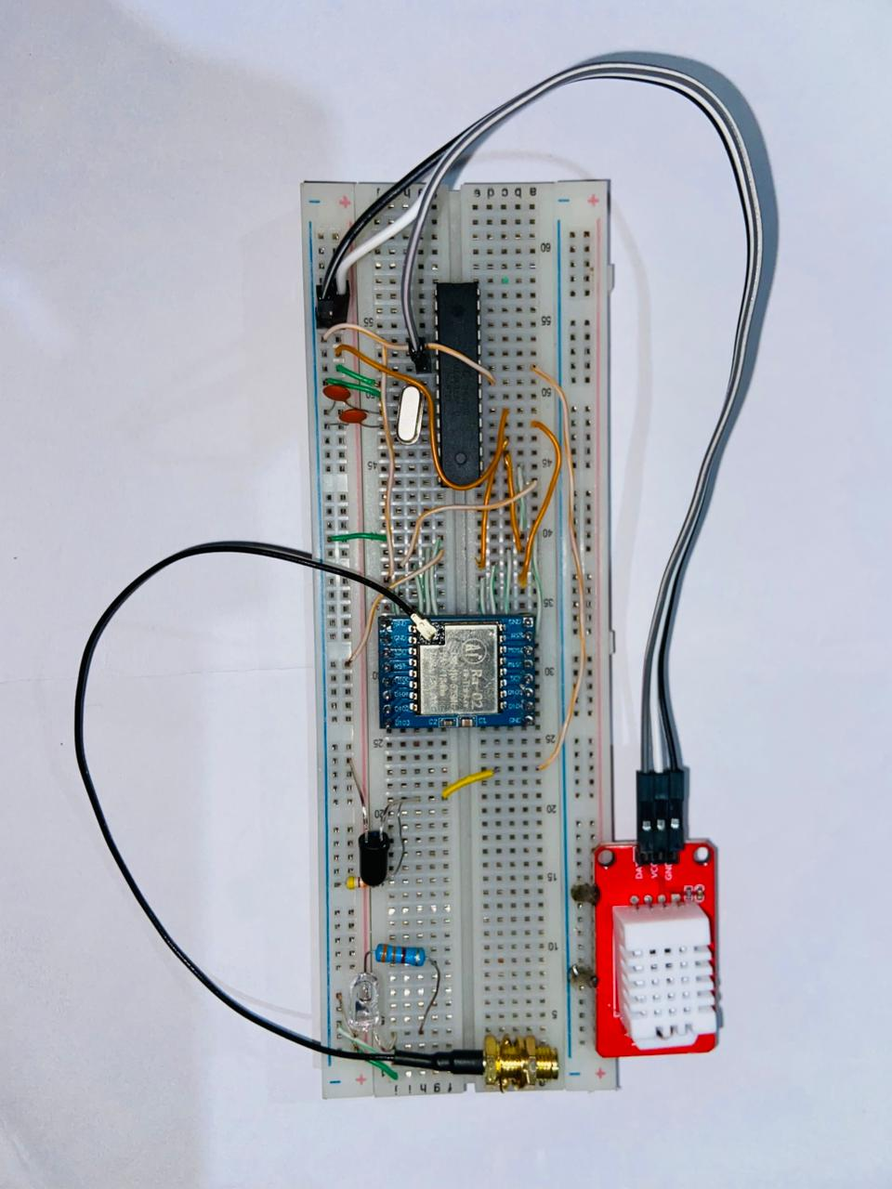
Breadboard-Based Prototype
Transmitter

Slide 12
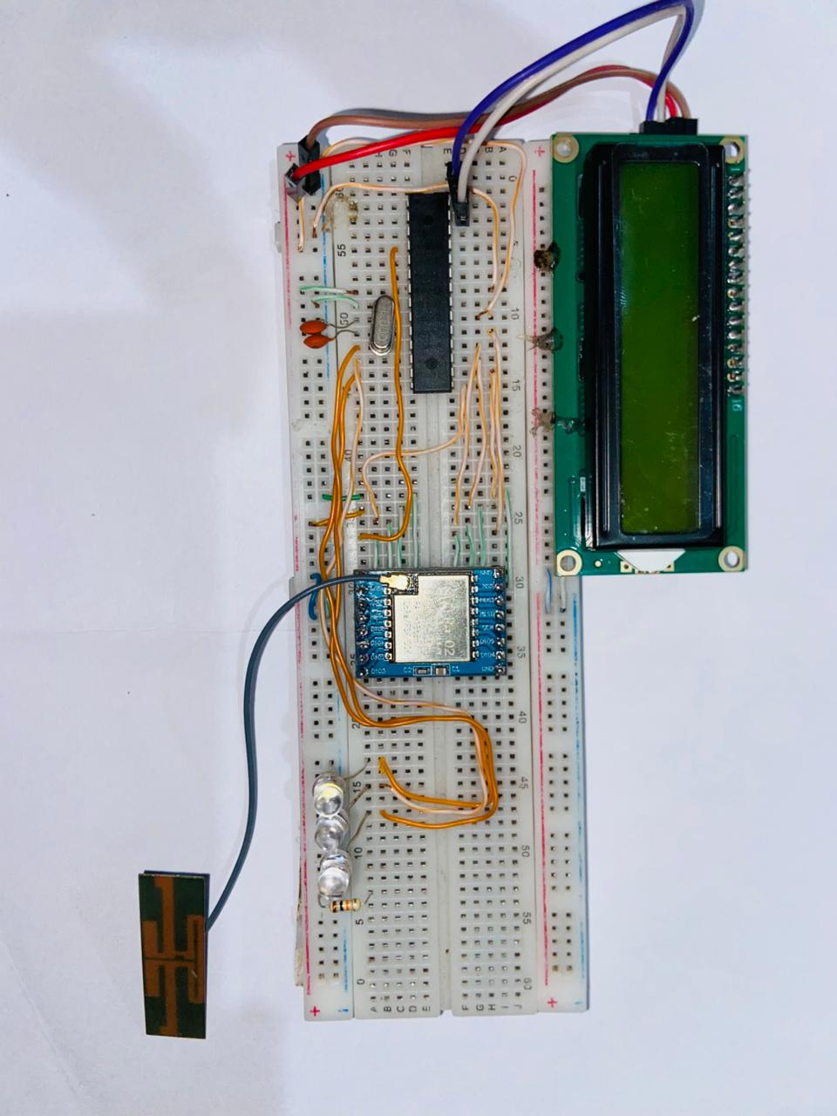
Breadboard-Based Prototype
Receiver

Slide 13
Challenges Faced During Implementation
Required components were not available in Proteus.
Photocell was unavailable, replaced with LDR.
LDR showed high sensitivity to ambient light, causing unstable and inaccurate readings. → Switched to IR sensor for reliable performance.
LoRa communication initially failed due to antenna issues. → Changed antennas for proper transmission.
Breadboard connection issues (jumper wire errors and loose contacts). → Replaced with proper wiring for stable operation.

Slide 14
Work Completed So Far
Project proposal finalized
Literature survey completed
ATmega328P standalone setup completed
Bootloader burning and debugging done
LoRa TX–RX communication tested successfully
Basic fog level logic implemented
GitHub repository created and maintained
LoRa data transmission tested successfully
Fog level data sent from transmitter to receiver
Receiver displays warnings using LCD and LEDs
Serial monitor used for debugging and verification

Slide 15
Budget Overview
Component | Quantity | Estimated Cost
ATMEGA328P-PU | 2 | 1700.00
LoRa Ra-02 SX1278 Module | 2 | 3400.00
DHT22 Sensor | 1 | 340.00
16MHz Crystal + Capacitors | 2 | 30.00
I2C LCD Display + Adapter | 1 | 500.00
IR LED 5mm Infrared Transmitter & Receiver | 2 | 40.00
LEDs | 3 | 15.00
Resisters | 5 | 10.00
Total Cost |  | 6035.00

Slide 16
Timeline
 | Week
 | 2 | 3 | 4 | 5 | 6 | 7 | 8 | 9 | 10 | 11 | 12 | 13 | 14
Problem identification & literature review
Circuit design & proposal making
Component Selection and Acquisition
Firmware development
Hardware assembly
Documentation & GitHub setup
Testing & calibration
Final demonstration
Task

Slide 17

THANK YOU.!
Group members:
LIYANAGE L.D.R.K. 2022E082
LIYANAWATHTHAGE L.B.K. 2022E083
DE COSTA M.S.M. 2022E092
MADUSHANKA W.N.L. 2022E167
WANNINAYAKA W.M.I.M. 2022E169

